Slide 1
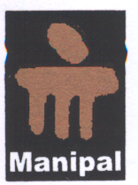

MEDICAL PROFILE ANDROID APPLICATION
SUBMITTED BY:
SURYADEEP CHATTERJEE(20120407)
GUIDED BY:
Mr. SUKRIT SEN
TEKNOKOM PVT LTD
DEPARTMENT OF COMPUTER SCIENCE AND ENGINEERING
SIKKIM MANIPAL INSTITUTE OF TECHNOLOGY
MAJITAR, RANGPO, EAST SIKKIM – 737136
DATED: 01/05/2016

Slide 2
PROJECT TITLE: | MEDICAL PROFILE ANDROID APPLICATION
GROUP MEMBER: | SURYADEEP CHATTERJEE(20120407) 8017889157 chatterjeesuryadeep@gmail.com
GROUP ID: | 58
ORGANIZATION NAME: | TEKNOKM PRIVATE LIMITED Unit 203, B.I.A. Merlin Chambers 18 British Indian Street Kolkata 700069 India
GUIDE NAME: | Mr . SUKRIT SEN 08334917615 sensukrit108@gmail.com

Slide 3
INDEX
SL NO. | HEADING | PAGE NO.
1. | Abstract | 4
2. | Problem Definition | 5
3. | Solution Strategy | 6
4. | Design | 8
5. | Implementation Details | 12
6. | Software Requirements | 15
7. | Results | 16
8. | References | 21

Slide 4
1. ABSTRACT
This is a mobile medical application which is capable of storing all the medical data we come across in our life.
All of us come across the state when we are not able to find some important medical prescription. This problem occurs because it’s a single page document.
To eradicate that problem this application will play an important role because it maintains a database that holds all the data.
This application will also help us reduce the problem of antibiotic misuse.

Slide 5
2. PROBLEM DEFINITION
This application will try to make it easy to handle medical documents.
This application will contain the following aspects :
Personal Information of user :
This part will contain the personal information of the user.
Medical history records :
This part will contain all the medical information of the user. This part will even store the prescription in an image format.
Medical Test Results:
This area will contain the test results the user has undergone in a graphical manner helping with improvement analysis.

Slide 6
3.0 SOLUTION STRATEGY
To implement the application I have used the concept of RESTful API web services as the strategy.
The back end is created by Node.js and mongo database while the front end is created by angular.js, HTML and CSS.
The front end interacts with the back end to show display in the application.
The front end of the application interacts with the database with the help of the server which is implemented with the help of REST api.

Slide 7
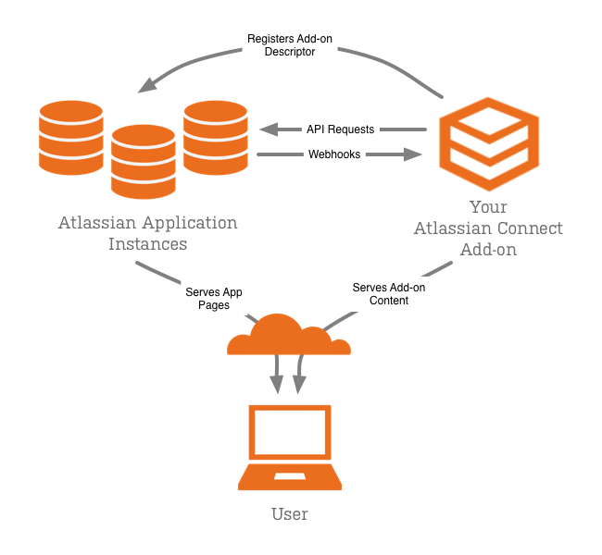
3.1 SOLUTION STRATEGY

Slide 8
4.0 DESIGN
The app is developed using cross platform IONIC 2.0.
Cordova plugins are also used with maximum use of npm.
The web server implemented using the concept of REST api is responsible for all the interactions between the client and database.
The web server has been launched at my company’s designated server which I am not allowed to disclose.
Thee images are stored in Firebase image uploading storage. The link to which cannot be disclosed because it is a paid service.

Slide 9
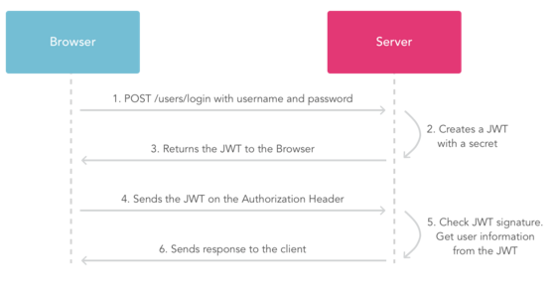
4.1 DESIGN

Slide 10
4.2 DESIGN
There are various strategies that are use to perform user authentication.
I have used JWT token based system. Like the name suggests, it uses token based confirmation to authenticate users.
The username must be unique.
The password is stored in database after encoding. The encoding is done using bcrypt.

Slide 11
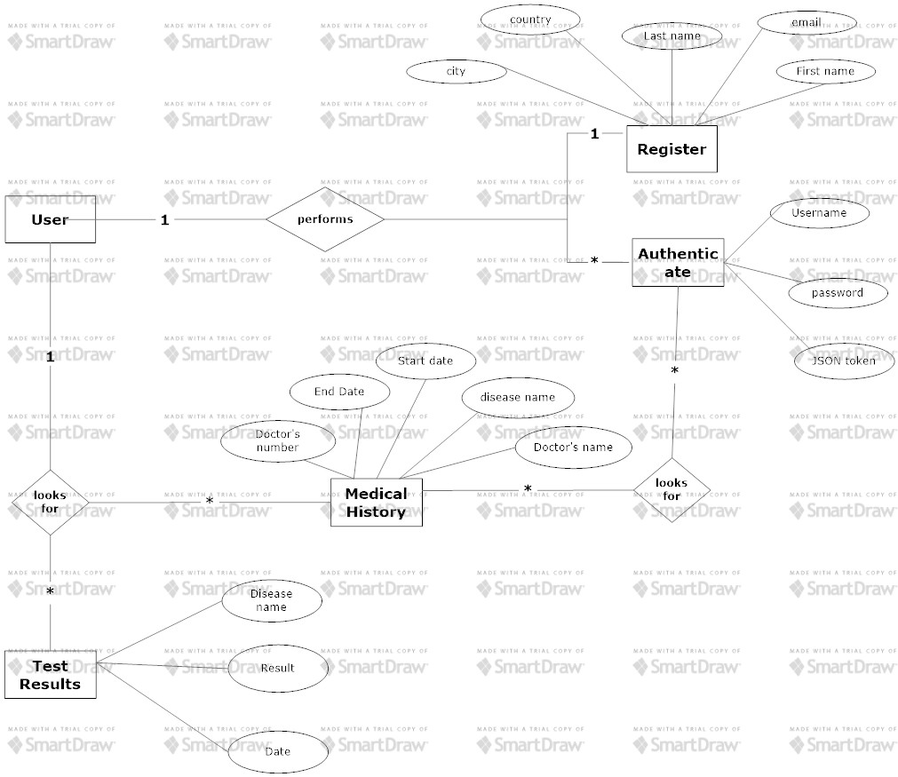
4.3 DESIGN
I have use this software to create this E-R diagram. The s/w wont let me remove the background.

Slide 12
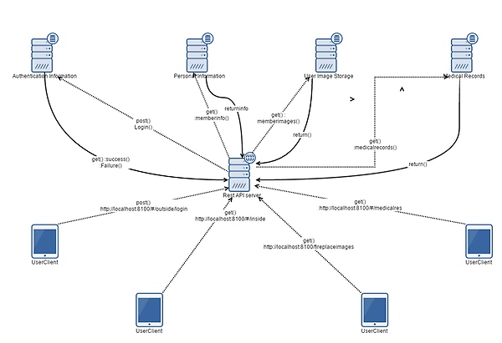
5.0 IMPLEMENTATION DETAILS

Slide 13
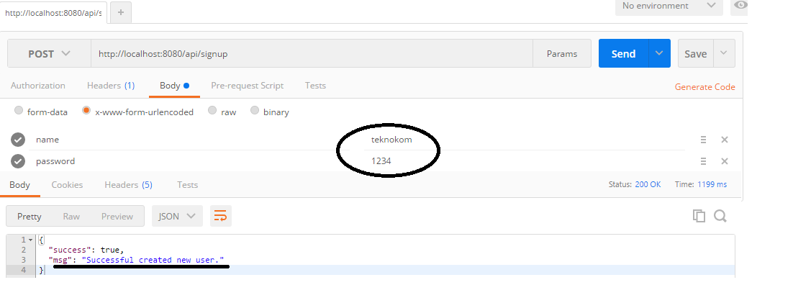
5.1 IMPLEMENTATION DETAILS
To check the backend web REST api I have used google POSTMAN app. This app returns true if the rest api is present at the provided location in the server.

Slide 14
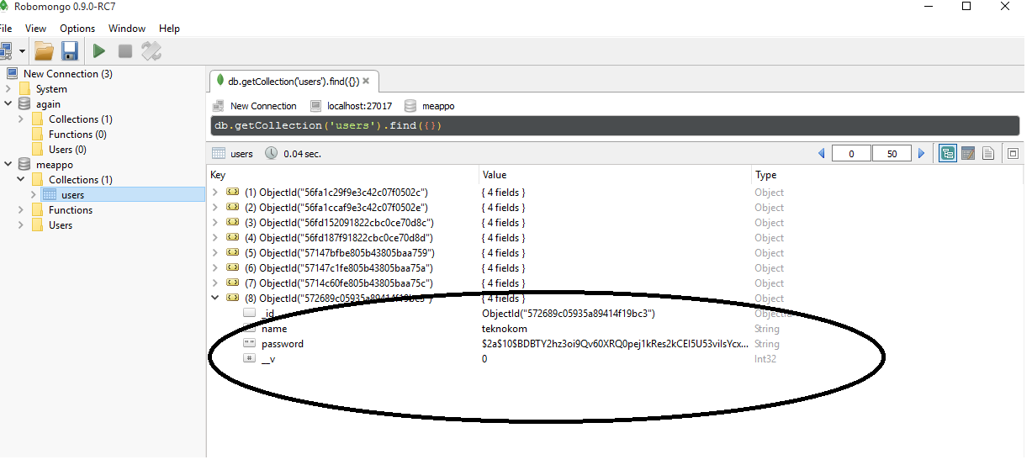
5.2 IMPLETATION DETAILS
Robo mongo is an application that is used to check the database at the back end.

Slide 15
6. SOFTWARE REQUIREMENTS
Express js : This is a demo server used to implement REST server.
Mongo DB: This is the database that is used to store user data.
Firebase account : the images that are being uploaded are stored in the firebase storage.
Ionic 2.0 : This is a cross platform that is used to create applications using npm.
Passport js : This is used to implement JWT token strategy.
Angujar.js : This is used to create the front end.
Node.js : This is used to create the back end server.
Chart.js : This package is used to create charts. This is used along wih the wrapper angular-chart.js(minified version).
Robo mongo :This is used to check the database.
Postman : this is a google app used to check the web REST api.

Slide 16
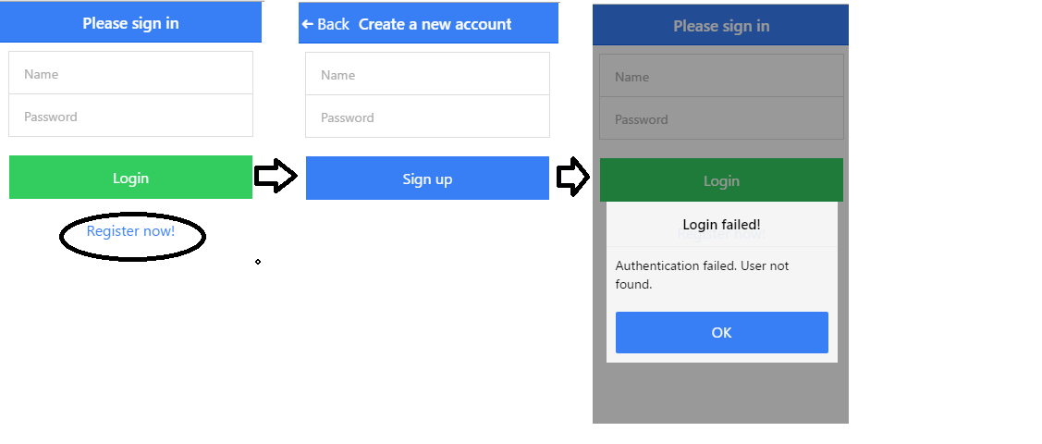
7.0 RESULTS

Slide 17
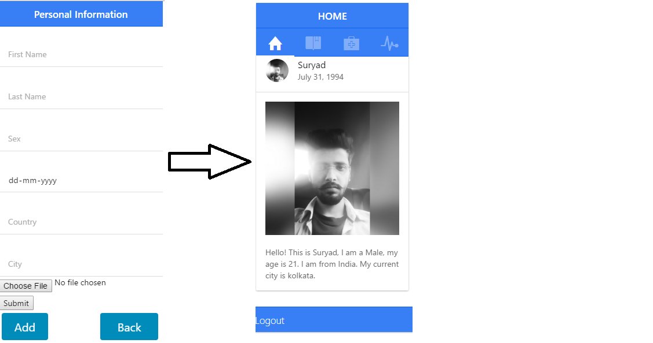
7.1 RESULTS

Slide 18
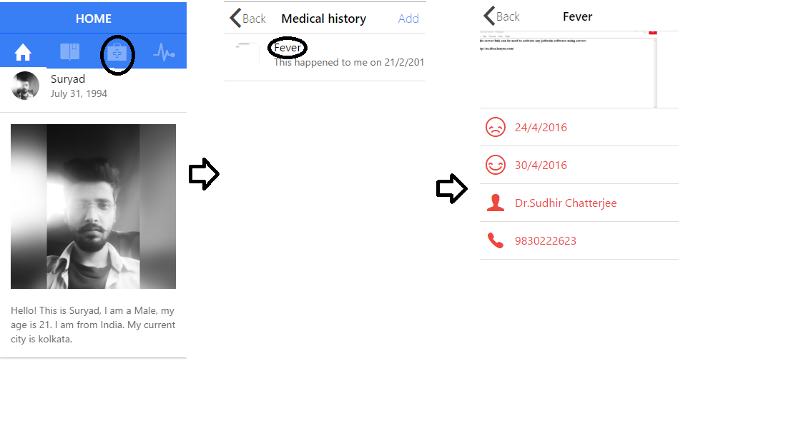
7.2 RESULTS

Slide 19
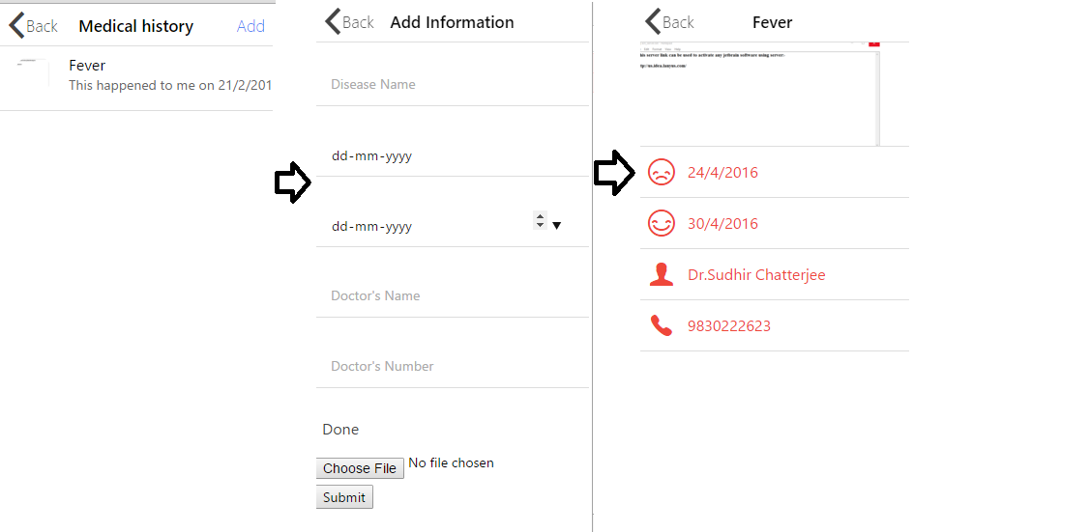
7.3 RESULTS

Slide 20
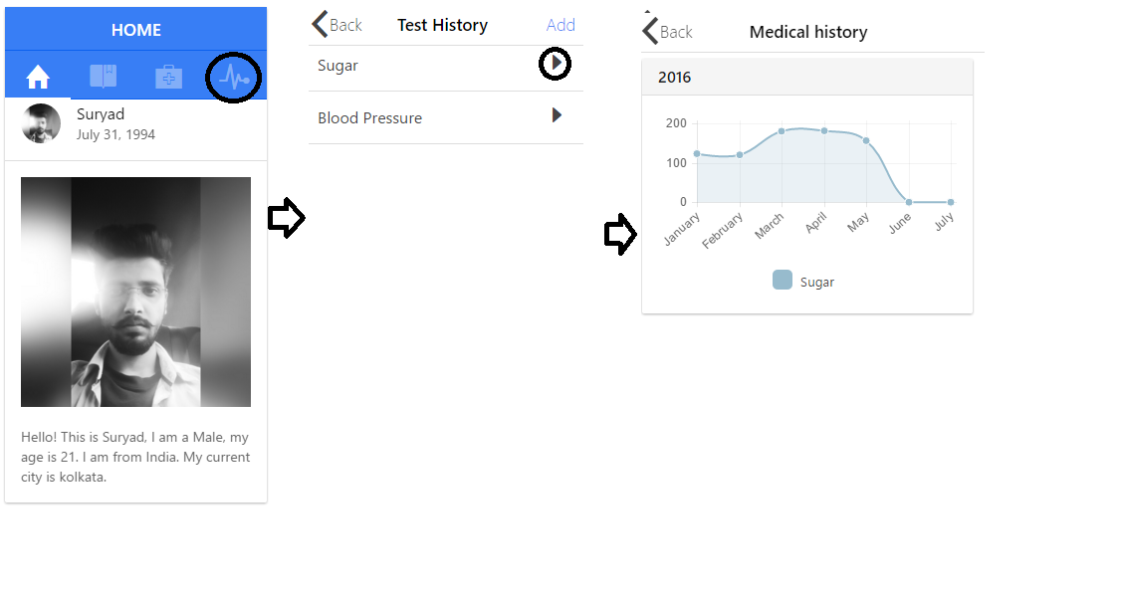
7.4 RESULTS

Slide 21
8. REFERENCES
http://jtblin.github.io/angular-chart.js/dist/angular-chart.js
http://jtblin.github.io/angular-chart.js/bower_components/Chart.js/Chart.js
http://jtblin.github.io/angular-chart.js/dist/angular-chart.css
https://docs.npmjs.com
http://ionicframework.com/docs/components/#utility
https://jwt.io/introduction/
https://www.npmjs.com/package/angular-chart.js/
https.//www.gliffy.com (web software I used to create diagrams I used in this presentation)

Slide 22
Thank you!

